Slide 1
Microsoft HoloLens
Computer Interfacing
CSE-405

Slide 2
Group Members
Ayon Roy (201714018)
Aqib Alfaz (201714024)
Nafiz Imtiaz Saimon (201714034)

Slide 3
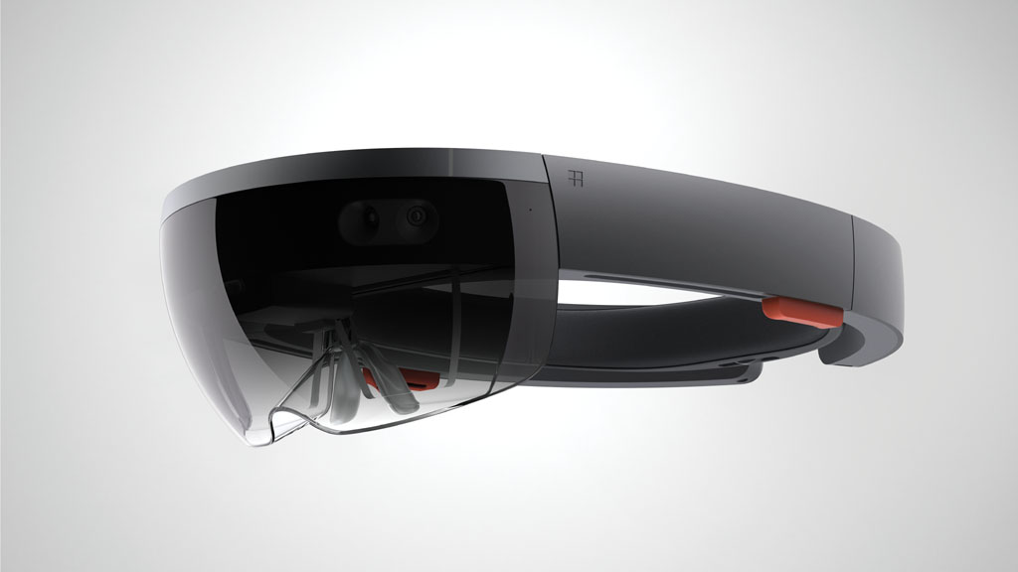

Slide 4
What is Microsoft HoloLens?
Microsoft HoloLens is the first holographic computer, Powered by Windows 10.
It is completely unattached ( no wires, phones, or connection to a PC needed).
Microsoft HoloLens is the fully untethered ,holographic computer ,enabling high definition holograms to integrate with your world.
Microsoft HoloLens Place holograms in your locations you choose and your digital content will feel more real than ever before.

Slide 5
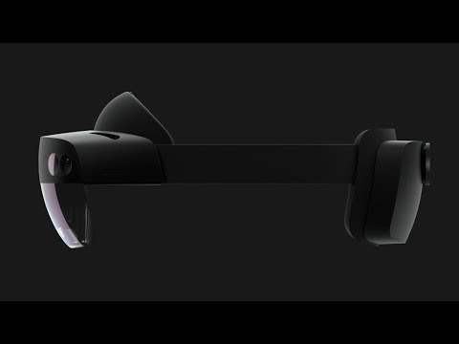

Slide 6
Augmented Reality
“Augmented reality is a live direct or indirect view of a physical, real-world environment whose elements are augmented by computer generated sensory input such as sound, video, graphics and data ”

Slide 7
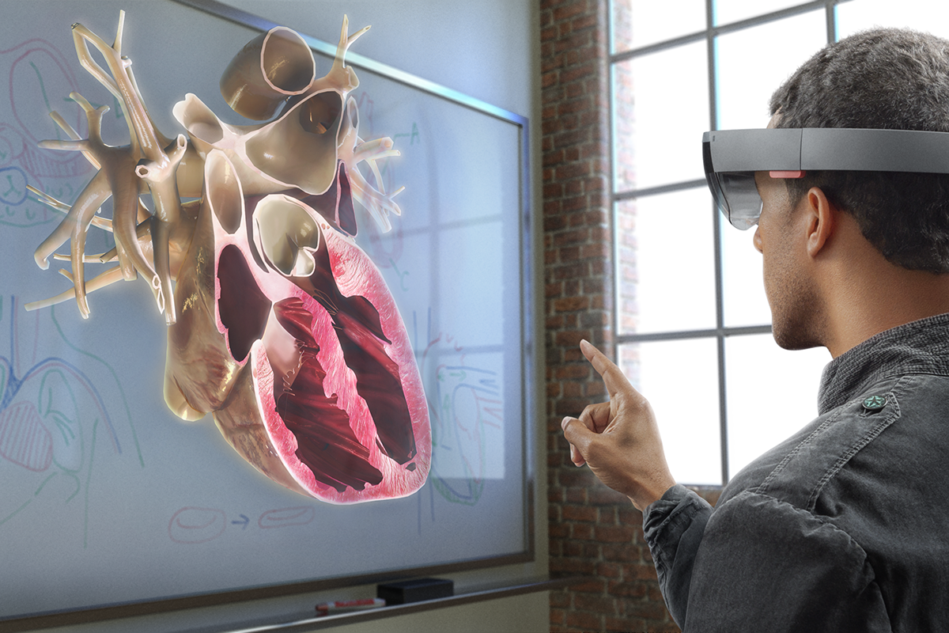
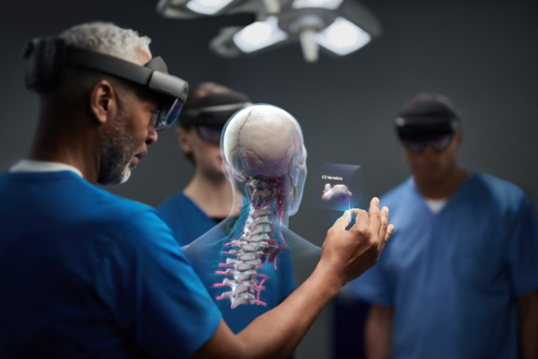
Purpose
Medical Purpose

Slide 8
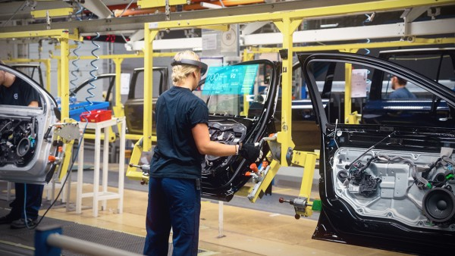
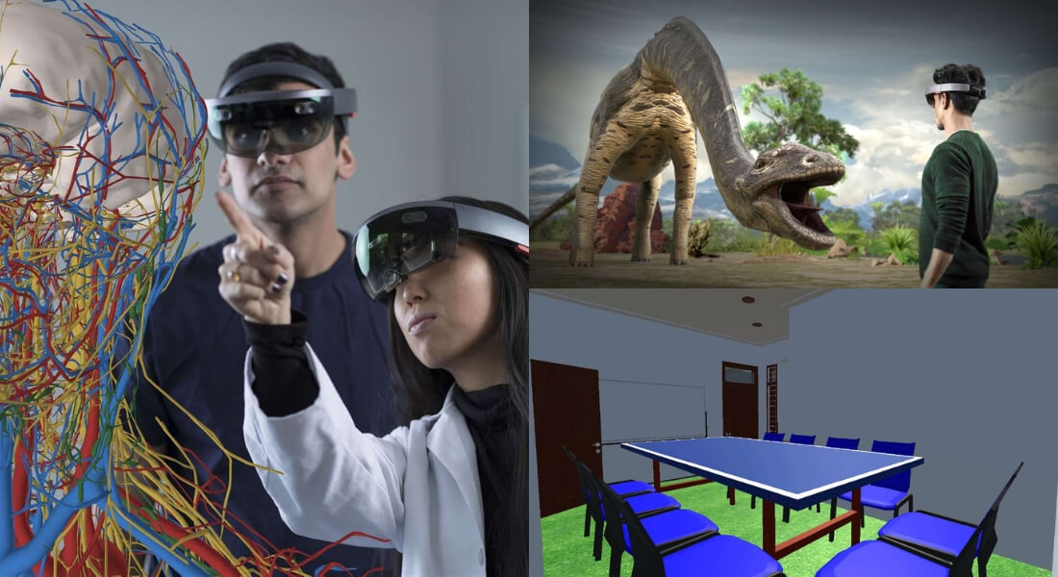
Purpose
Industrial Purpose
Educational Purpose

Slide 9
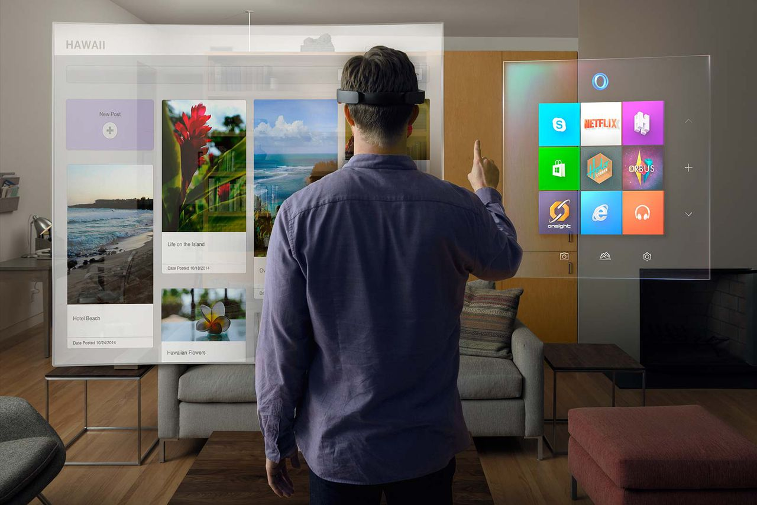
Purpose
Entertainment

Slide 10
Features
Visualization
•Enables the user to visualize surrounding which is not directly visible
•Get visual insight of an object or model
•Modelling of non-existing objects
Education
•Experience learning
•Getting more realistic teaching by moving 2D presentations in books to 3D holographic models

Slide 11
Features
Working together
•Support through linked view, voice and gestures
•Meetings around Holographic objects
•Working together on projects whereby visualization is an important part
•Working together when distance is involved.
Media & entertainment
•Enrich media with additional holographic objects
•Play games as part of your real-world environment
•Game interaction with your walls, ceiling and floor.

Slide 12
Components
An Intel Cherry Trail SoC containing the CPU and GPU
A custom-made Microsoft Holographic Processing Unit (HPU), a coprocessor manufactured specifically for the HoloLens
SoC and HPU each have 1GB LPDDR3 and share 8MB SRAM
SoC also controlling 64GB eMMC and running the Windows 10 operating system
HPU uses 28 custom DSPs(Digital Signal Processor) from Tensilica to process and integrate data from the sensors, as well as handling tasks such as spatial mapping, gesture recognition, and voice and speech recognition

Slide 13
Components
An inertial measurement unit (IMU) (which includes an accelerometer, gyroscope, and a magnetometer) four "environment understanding" sensors (two on each side)
An energy-efficient depth camera with a 120°×120° angle of view
A 2.4-megapixel photographic video camera
A four-microphone array
An ambient light sensor
An IEEE 802.11ac Wi-Fi and Bluetooth 4.1 Low Energy (LE) wireless connectivity.

Slide 14
Working Principle

Slide 15
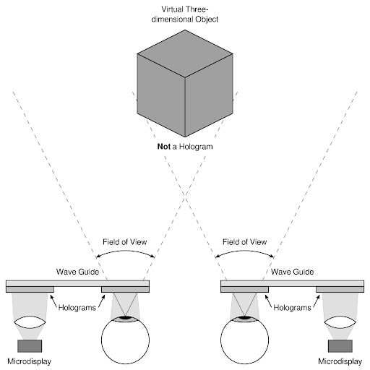

Slide 16
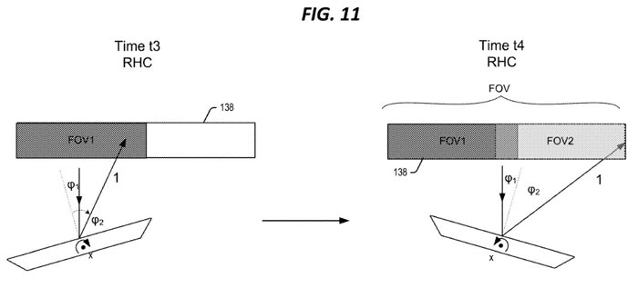

Slide 17
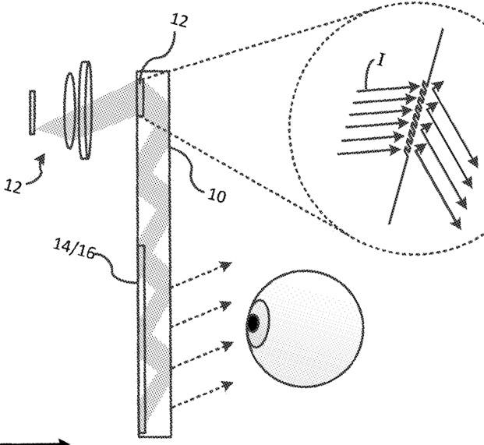

Slide 18
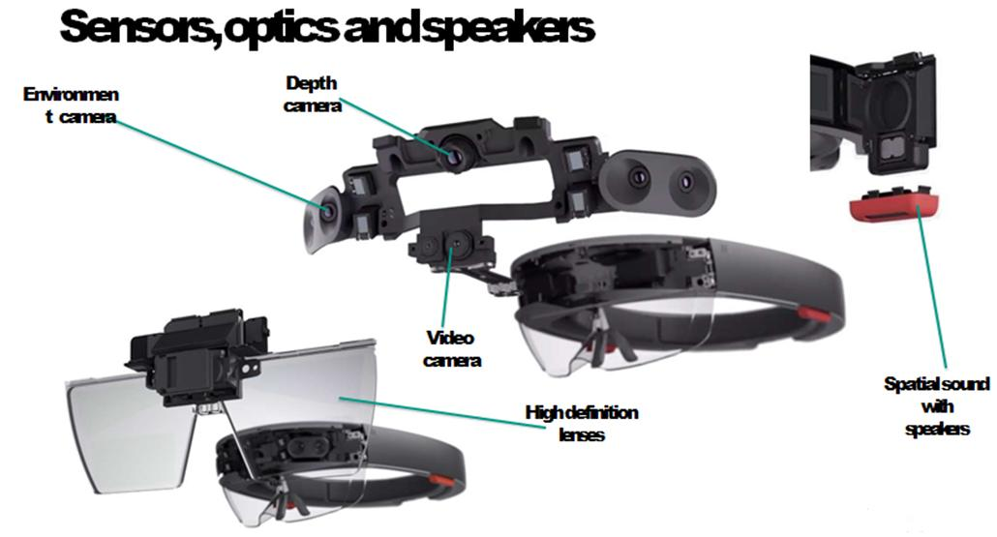

Slide 19
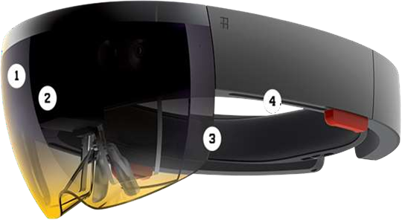
Interface Design
Inside the HoloLens
1. Camera
2. Computer
3. Lenses
4. Vent
5. Sensor
6. Buttons

Slide 20
Interface Design
Computer: HoloLens is not just a visor connected to a computer, it is a computer on its own. HoloLens contain CPU, battery, GPU and first of its kind HPU (holographic processing unit). 18 sensors flood the brain of the device with terabyte of data every seconds.
Camera: The project HoloLens depth camera has a field of vision that spans 120 by 120 degree, so it can sense what your hands are doing even when they are nearly outstretched.

Slide 21
Interface Design
Sensor: sensor track where the wearer is looking and adjust the display.
Motion sensor detect wearers movement.
The sensor can also see wearers hands, the hands are an Input system User can interact with whatever he sees by just touching it.
Wearer also give gesture as input sensor enables the tracking of user movement.

Slide 22
Interface Design
Vent: the device is more powerful than a laptop but won’t overheat- warm air flows to the sides, where it vents up and out.
Buttons: on the right side buttons allow user to adjust the volume and to control the contrast of the hologram.

Slide 23
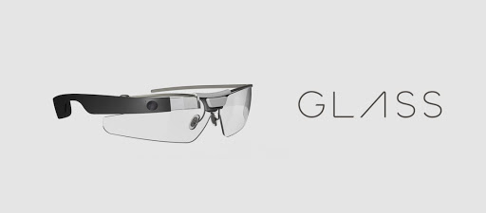
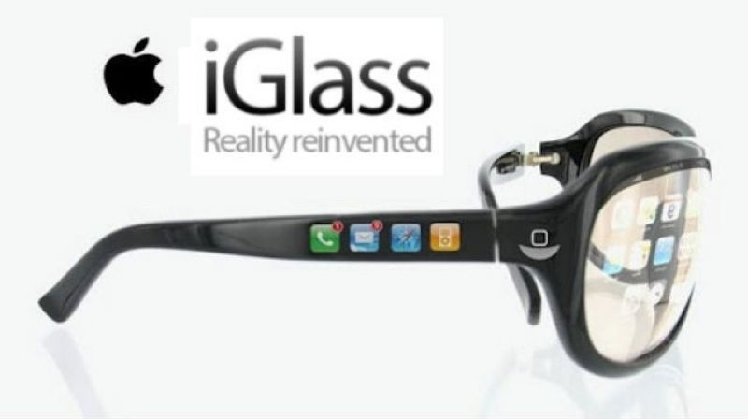
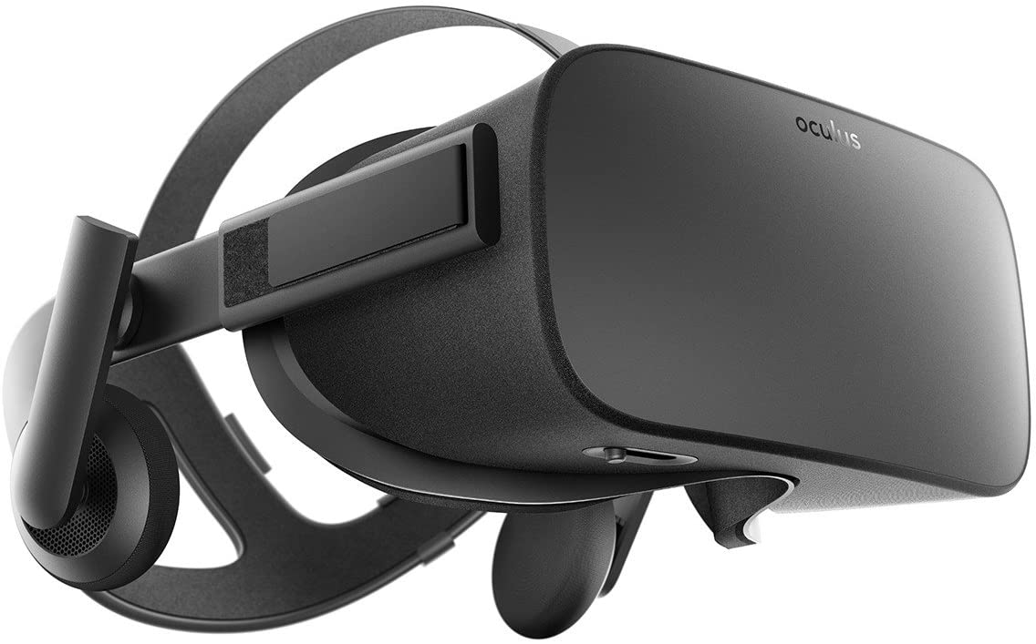
Related Work
Google Glass
Apple Glass (upcoming)
Oculus Rift

Slide 24
Thank You

